Slide 1
EC601 Project 2
Google Maps and OpenAI integration
Krishna Saharsh M

Slide 2
Product Mission
Mission Statement
Empowering Seamless and Personalized Location-based Conversations
Our mission is to seamlessly integrate Google Maps and ChatGPT to create an innovative and user-centric solution that enhances the way people navigate and communicate in the digital world. We aim to provide users with an intelligent and conversational way to access location-based information and services, making their everyday experiences more convenient and efficient.

Slide 3
User Stories (Top)
As a traveler, I want to ask for directions and receive real-time updates on traffic and alternative routes, so I can plan my journey efficiently and avoid traffic congestion.
As a tourist, I want to inquire about nearby attractions and receive personalized recommendations based on my interests and preferences, so I can make the most of my visit to a new city.
As a local resident, I want to find the best-rated restaurants in my area and make reservations through the integrated system, so I can easily plan dinners with friends and family.
As a hiker, I want to get information about nearby hiking trails, their difficulty levels, and elevation profiles, so I can choose the right trail for my fitness level and interests.
As a business traveler, I want to book a ride from the airport to my hotel and receive an estimated fare, so I can arrange transportation quickly upon arrival in an unfamiliar city.

Slide 4
Minimum Viable Product (MVP)
Conversational Location Queries: Users can engage in both text-based and speech-based conversations to ask for directions and information about nearby places.
Basic Location Search: The system can provide directions and information based on user queries like "Find me the nearest coffee shop" or voice commands like "How do I get to the Eiffel Tower?"
Real-Time Traffic Updates: Users can request real-time traffic information through voice commands and receive suggested alternative routes if there are delays.
Personalized Recommendations: Users can receive recommendations for nearby places based on basic preferences and daily routine patterns, and they can specify their preferences through voice commands (e.g., "Suggest a nearby Italian restaurant").
Location Data Retrieval: Users can ask for coordinates, distances, and basic information about locations or landmarks using both text and speech.
Responsive Maps: Users can interact with static maps provided in the chat interface through text and speech. They can ask to zoom in/out, pan, or request information about specific map features.

Slide 5
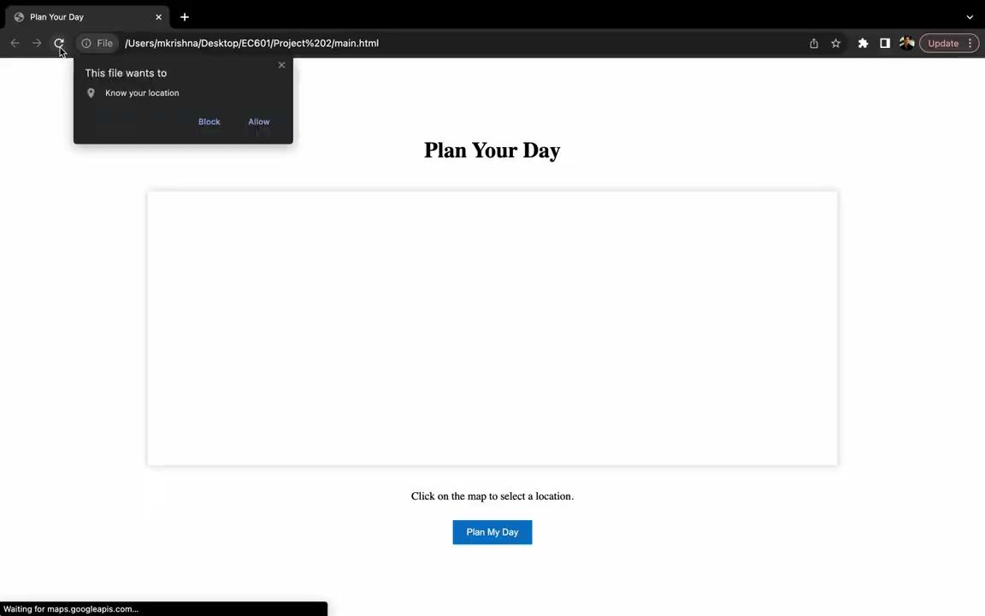
Video

Slide 6
Current Prototype Limitations
The prototype uses free OpenAI API key, hence requests are limited and cannot run all the time.
Only 1 of the many MVP features are displayed.
Integration is presented using a webpage.

Slide 7
Thank You.

